Slide 1
Early Detection of Alzheimer’s Disease Using SMOTE+ENN on an Unbalanced Dataset
Members Name: Mayank Mukherjee, Anshuman Singh, Nikhil Rajput, Mayank
Co-Author: Dr. S. Amudha

Slide 2
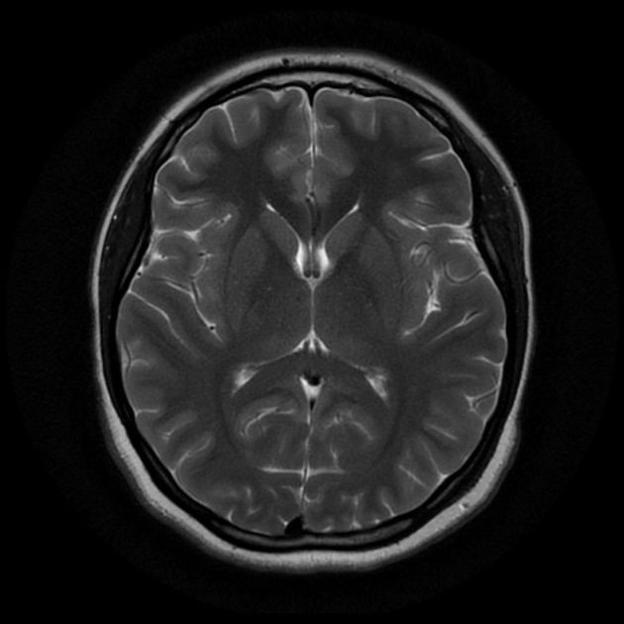
Introduction
Overview: Our work focuses on building a model, trained on Brain MRI-Scan image dataset using Deep Learning Algorithms to build a model which provides accurate prediction of Alzheimer’s disease. For our novel idea we have trained with on an unbalanced image dataset and used SMOTE+ENN algorithm to achieve the better accuracy as modern-day models which use a balanced dataset.

Slide 3
Motivation
Our work tackles the challenges of early Alzheimer's disease detection using deep learning. The motivation stems from the critical need for timely diagnosis and the prevalence of imbalanced datasets in medical imaging. By employing SMOTE+ENN to balance the dataset, our study aims to develop a reliable and interpretable model, thus contributing to improved patient outcomes and healthcare advancements.

Slide 4
Novelty
The novelty of our work lies in its innovative approach to addressing two key challenges: imbalanced datasets and model interpretability. By applying SMOTE+ENN to balance the dataset our research offers a comprehensive framework for early Alzheimer’s disease detection, advancing machine learning in healthcare.

Slide 5
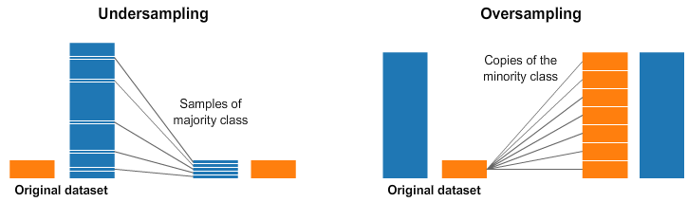
Problems
Building a Machine-Learning model revolves around having a vast dataset. Since there’s no such alternative, our model focuses on working with an Unbalanced Dataset. This removes limitation risen at the time of data collection.
Unbalanced Dataset:
Unbalanced dataset has unequal class distribution, affecting model performance by favoring majority class.

Slide 6
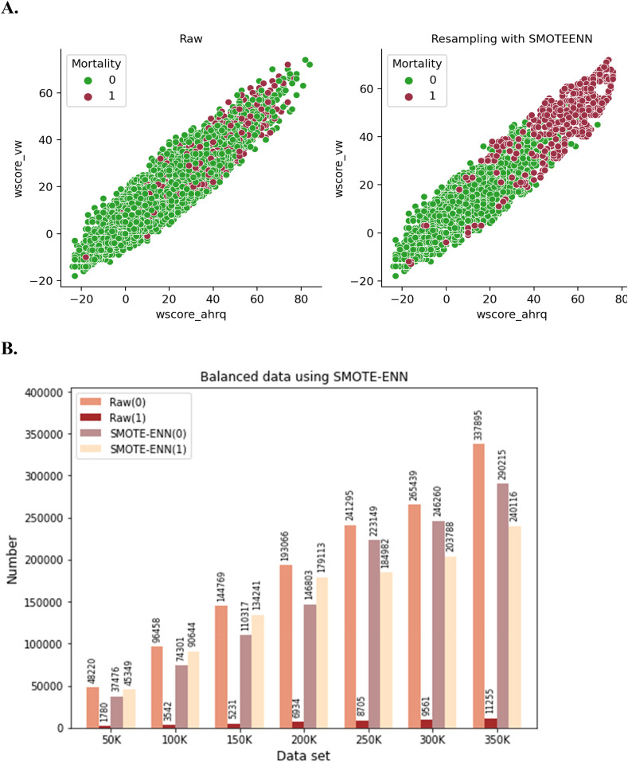
Proposed Solution
To remove dataset limitation, we used SMOTE+ENN algorithm to balance the image dataset.
We trained InceptionV3, ResNet50 and VGG19 models on dataset balanced using SMOTE+ENN algorithms and compared the results with the models trained on unbalanced dataset.

Slide 7
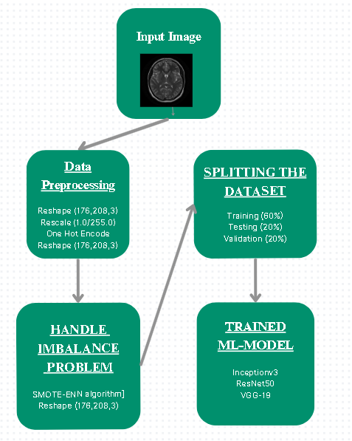
Architecture diagram

Slide 8
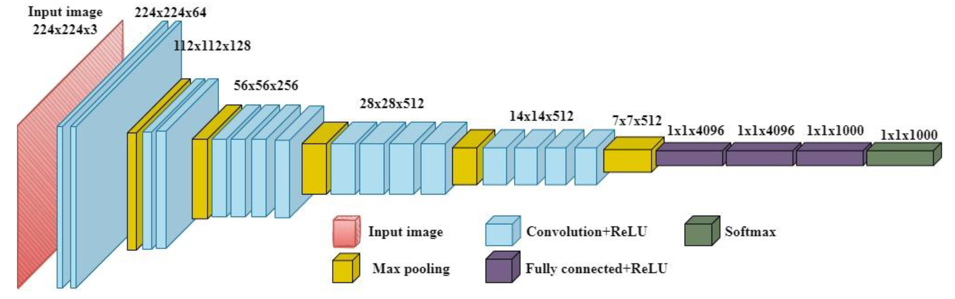
VGG19
VGG19 is a convolutional neural network architecture, named after the Visual Geometry Group at the University of Oxford. It consists of 19 layers, including convolutional layers followed by max-pooling layers, and ends with three fully connected layers. VGG19 is known for its simplicity and uniform architecture, which makes it easy to understand and implement. It's often used as a baseline or feature extractor in various computer vision tasks, such as image classification and object detection.

Slide 9
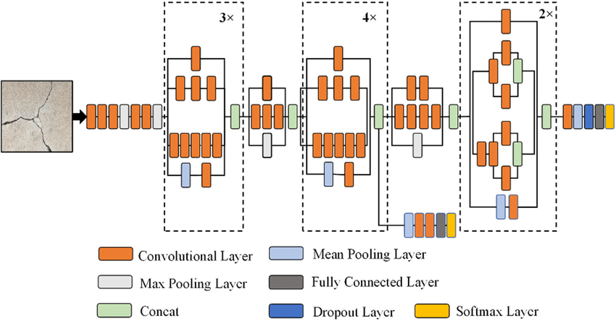
InceptionV3
InceptionV3 is a convolutional neural network architecture developed by Google, known for its innovative use of inception modules. With 48 layers, it efficiently captures features at various scales using parallel convolutional pathways. This design makes it adept at tasks like image recognition and classification while balancing complexity and computational efficiency.

Slide 10
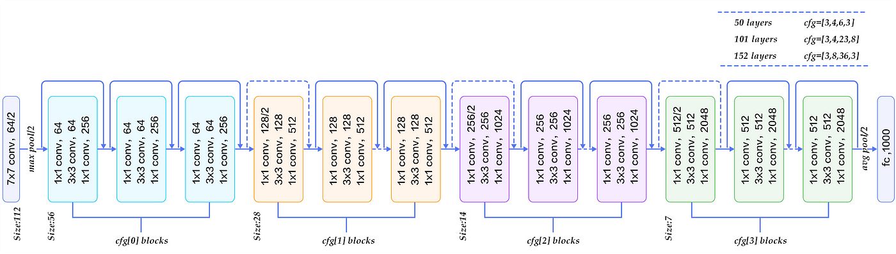
ResNet50
ResNet50 is a convolutional neural network architecture that introduced the concept of residual learning to address the vanishing gradient problem in deep networks. Developed by Microsoft Research, it consists of 50 layers and utilizes residual blocks, which allow the network to learn residual mappings instead of directly learning the desired underlying functions. This approach enables ResNet50 to train deeper networks more effectively while maintaining accuracy. ResNet50 is widely used for image classification, object detection, and other computer vision tasks due to its depth, simplicity, and superior performance compared to earlier architectures.

Slide 11
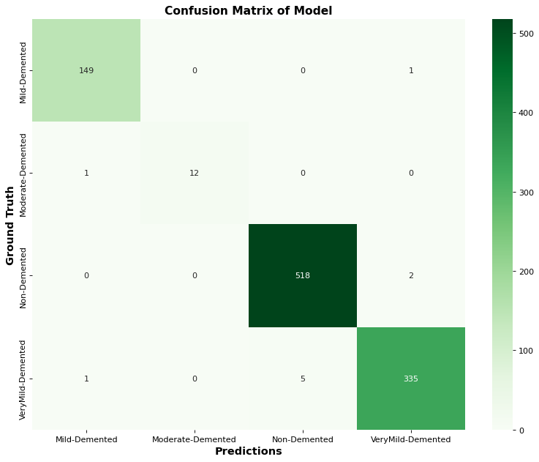
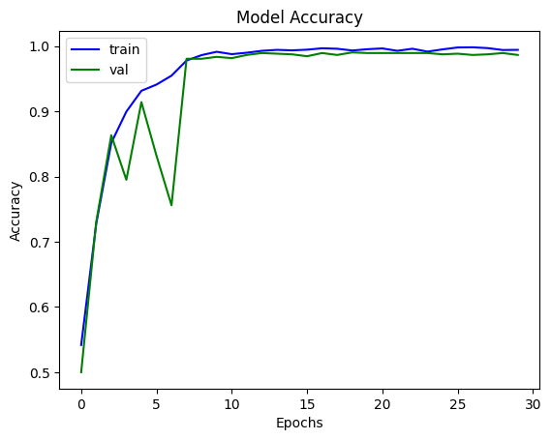
RESULTS AND DISCUSSION
INCEPTIONV3:
Testing Accuracy: 99.023438 %, Testing AC: 99.783707 %, Testing Precision: 99.120235 %, Testing Recall: 99.023438 % ,Testing F1-Score: 99.071813 %

Slide 12
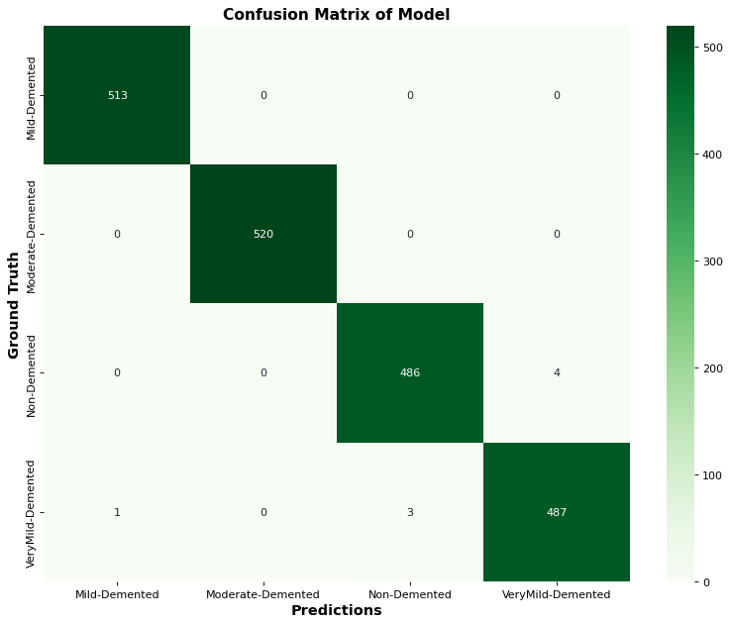
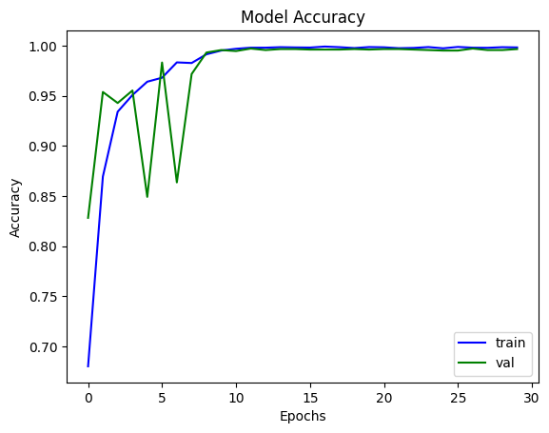
RESULTS AND DISCUSSION
INCEPTIONV3(WITH SMOTE+ENN):
Testing Accuracy: 99.602783 %, Testing AC: 99.962550 %, Testing Precision: 99.602586 %, Testing Recall: 99.553126 %, Testing F1-Score: 99.577850 %

Slide 13
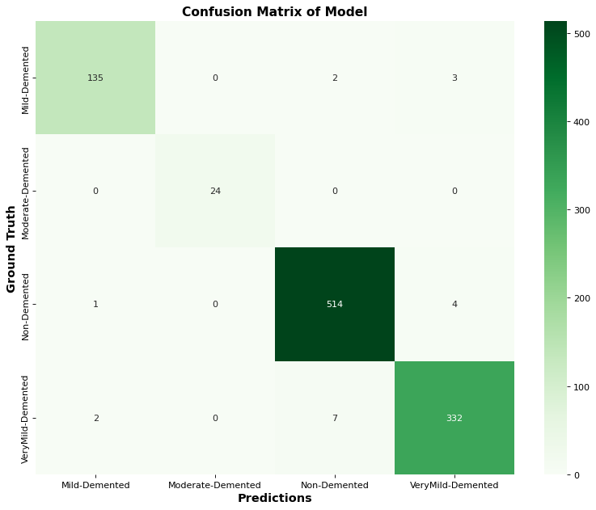
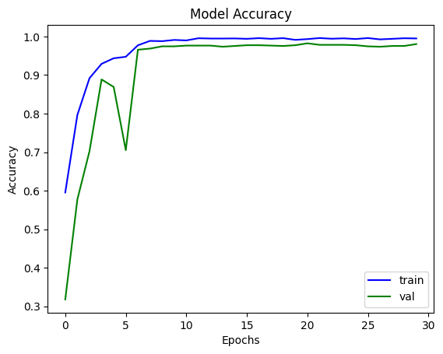
RESULTS AND DISCUSSION
RESNET-50:
Testing Accuracy: 98.144531 %, Testing AC: 99.914670 %, Testing Precision: 98.529410 %, Testing Recall: 98.144531 %, Testing F1-Score: 98.336594 %

Slide 14

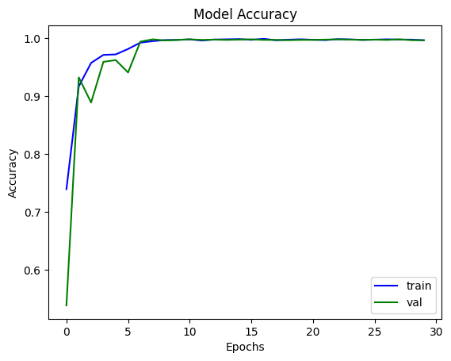
RESULTS AND DISCUSSION
RESNET-50(WITH SMOTE+ENN):
Testing Accuracy: 99.501991 %, Testing AC: 99.972272 %, Testing Precision: 99.501991 %, Testing Recall: 99.501991 %, Testing F1-Score: 99.501991 %

Slide 15

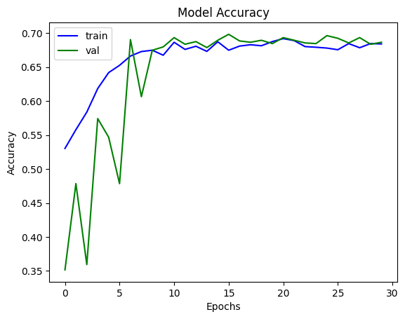
RESULTS AND DISCUSSION
VGG-19:
Testing Accuracy: 69.824219 %, Testing AUC: 91.583580 %, Testing Precision: 84.181815 %, Testing Recall: 45.214844 %, Testing F1-Score: 58.831003 %

Slide 16
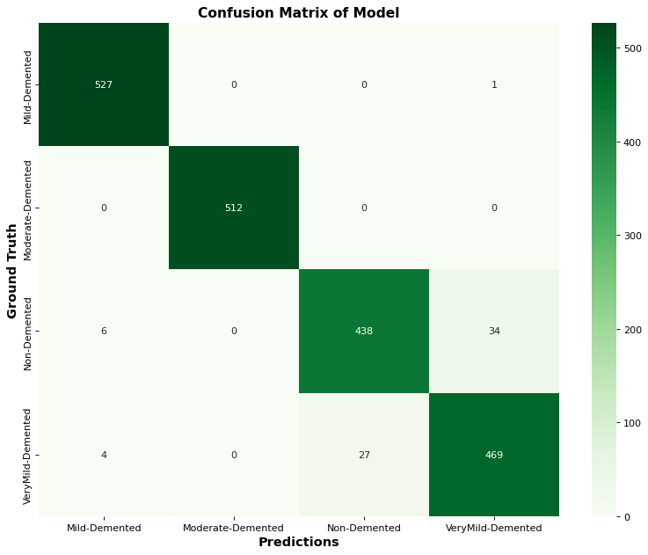
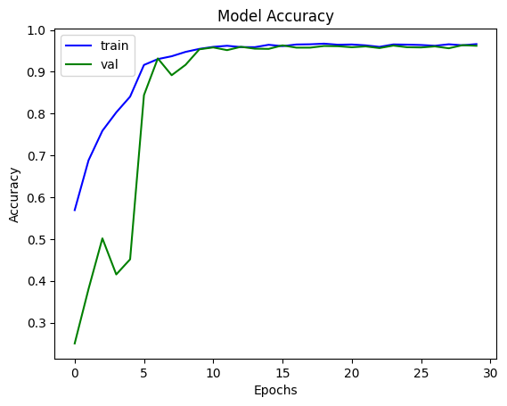
RESULTS AND DISCUSSION
VGG-19(WITH SMOTE-ENN):
Testing Accuracy: 96.432114 %, Testing AC: 99.847519 %, Testing Precision: 96.618599 %, Testing Recall: 96.283448 %, Testing F1-Score: 96.450732 %

Slide 17
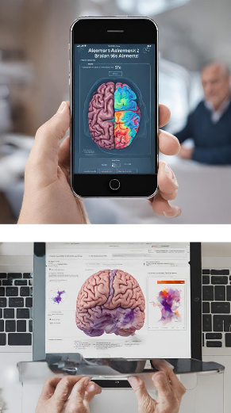

Future work (An ML tool for healthcare image classification.)
Our prototype model classifies Alzheimer disease stages from Brain-MRI dataset. We want to upscale to other such domains in Medical Image Classification field, and build a consultant application, targeting all kinds of brain-activity related diseases.

Slide 18
CONCLUSION
Thus, we developed a way to incorporate a Machine-Learning approach to the field of Healthcare image classification and built a model which classifies Brain-MRI image and delivers accurate prediction. We also found a way to work around an imbalanced dataset, which removes limitations around data collection and acquisition.

Slide 19
REFERENCES
1. Alzheimer's Association. (2020). 2020 Alzheimer's disease facts and figures.
2. Liu, M., et al. (2018). Detection and analysis of Alzheimer's disease using 3D convolutional neural network.
3. Samper-González, J., et al. (2018). Reproducible evaluation of classification methods in Alzheimer's disease.
4. Chawla, N. V., et al. (2002). SMOTE: Synthetic minority over-sampling technique.
5. Wilson, D. L. (1972). Asymptotic properties of nearest neighbour rules using edited data.
6. Selvaraju, R. R., et al. (2017). Grad-CAM: Visual explanations from deep networks via gradient-based localization.
7. Zhou, B., et al. (2016). Learning deep features for discriminative localization.
8. Esteva, A., et al. (2017). Dermatologist-level classification of skin cancer with deep neural networks.
9. Rajpurkar, P., et al. (2018). Deep learning for chest radiograph diagnosis: A retrospective comparison of the CheXNeXt algorithm to practicing radiologists.

Slide 20

Thank You A Presentation By: Mayank Mukherjee Anshuman Singh Nikhil Rajput Mayank Guide: Dr. S. Amudha

